Slide 1
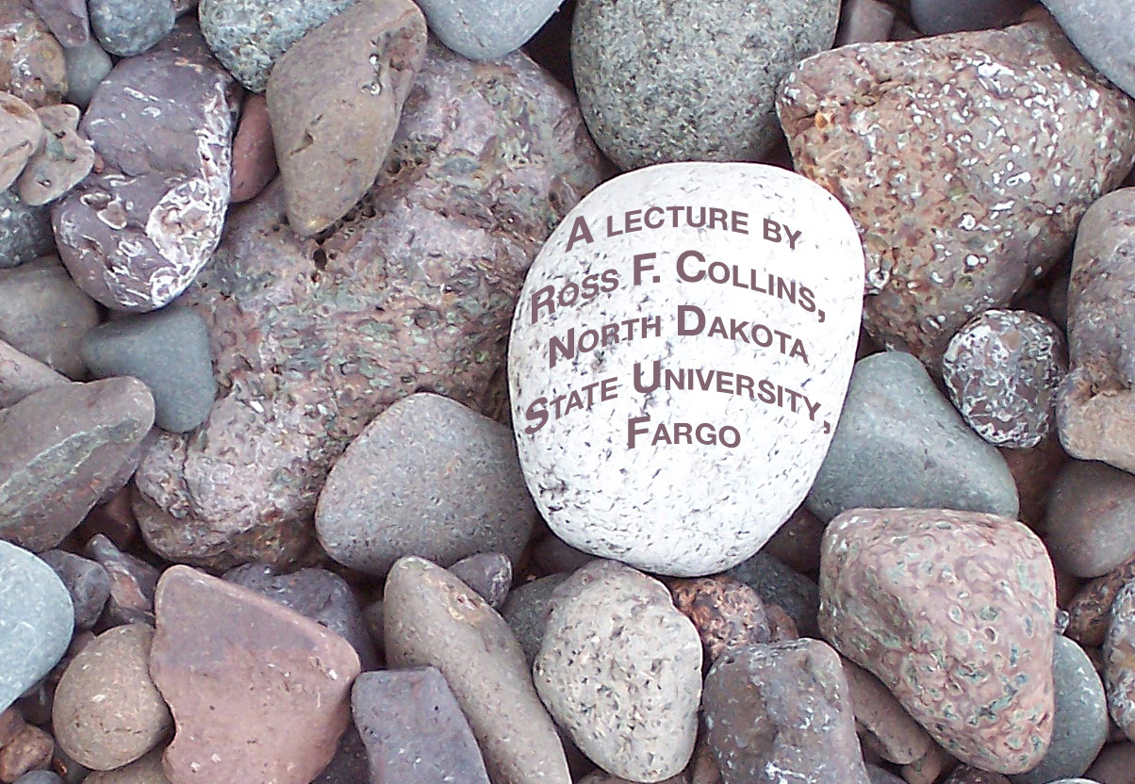
Travel photography
A sense of place

Slide 2
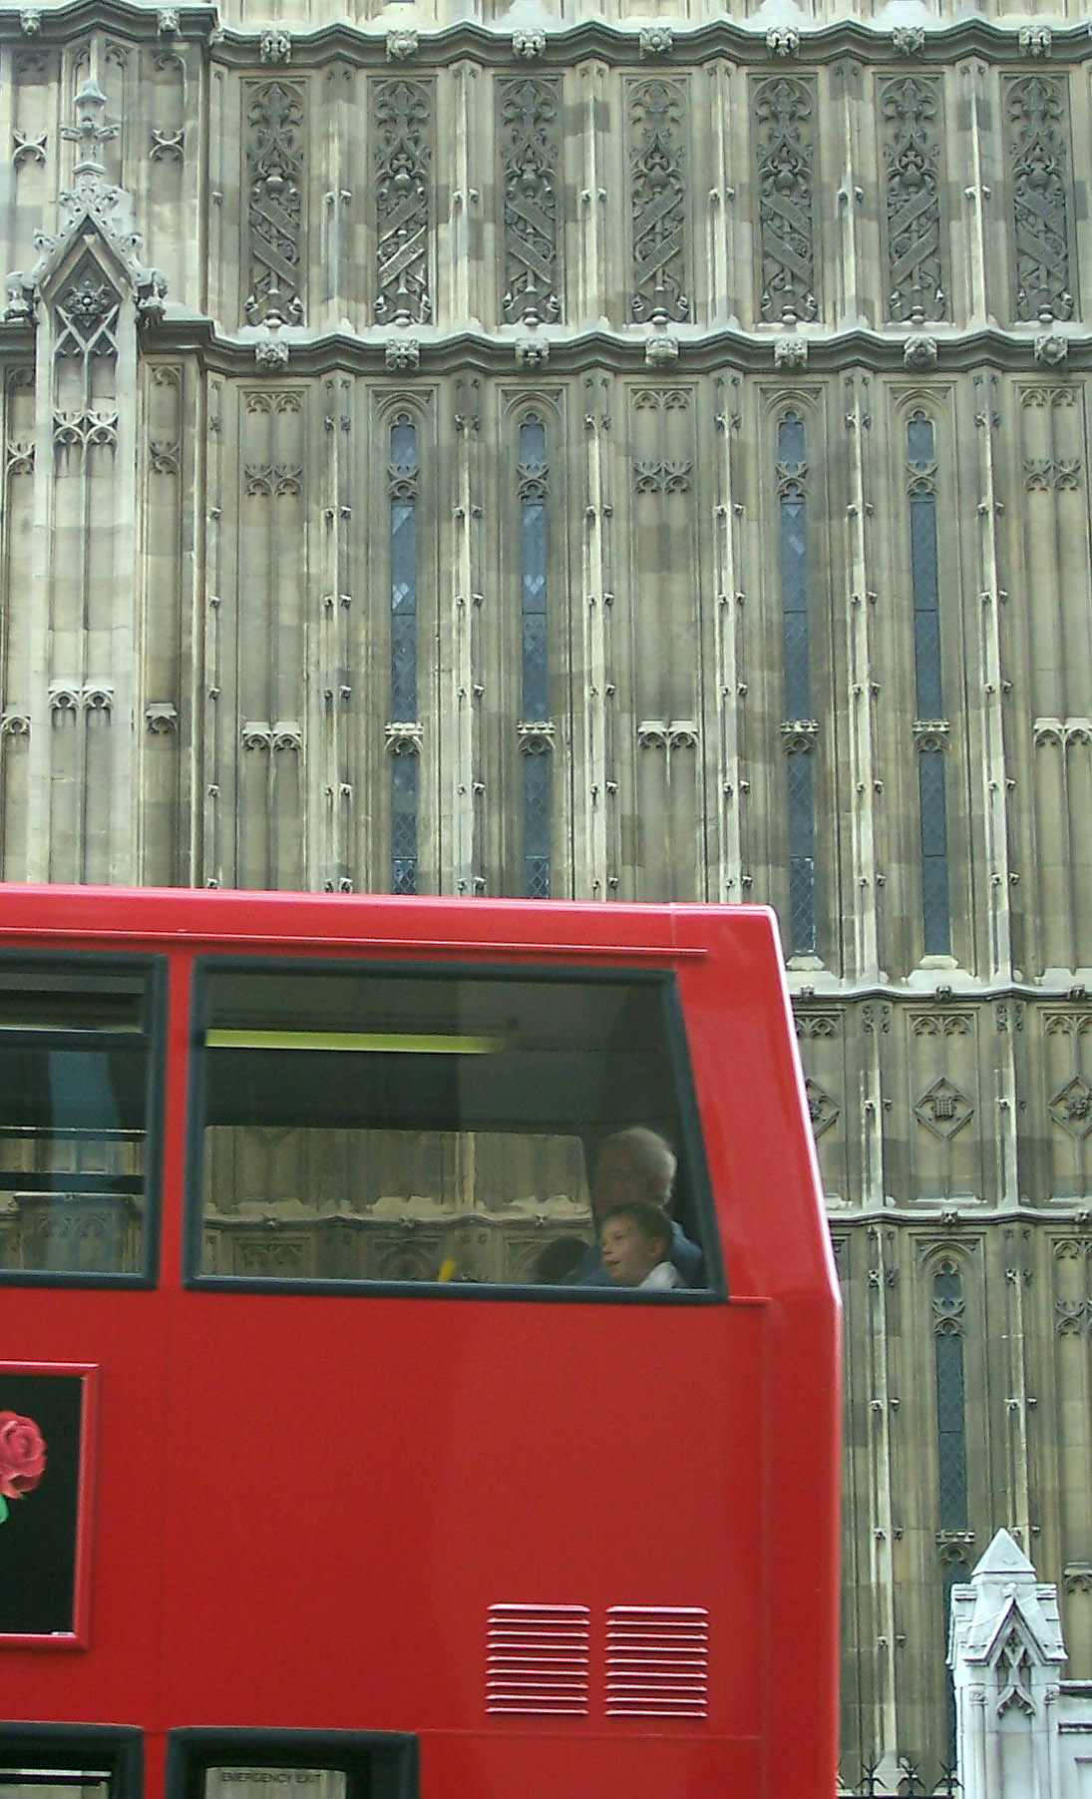
A sense of place
A goal of travel photography is to give viewers a feeling of what it was like to be in that location.
We call this a sense of place.

Slide 3
The essence
In travel photography we try to capture the essence of a community, a lake, a mountain range, a country.
We try to give our viewers the feeling that this could be no where else on earth.

Slide 4
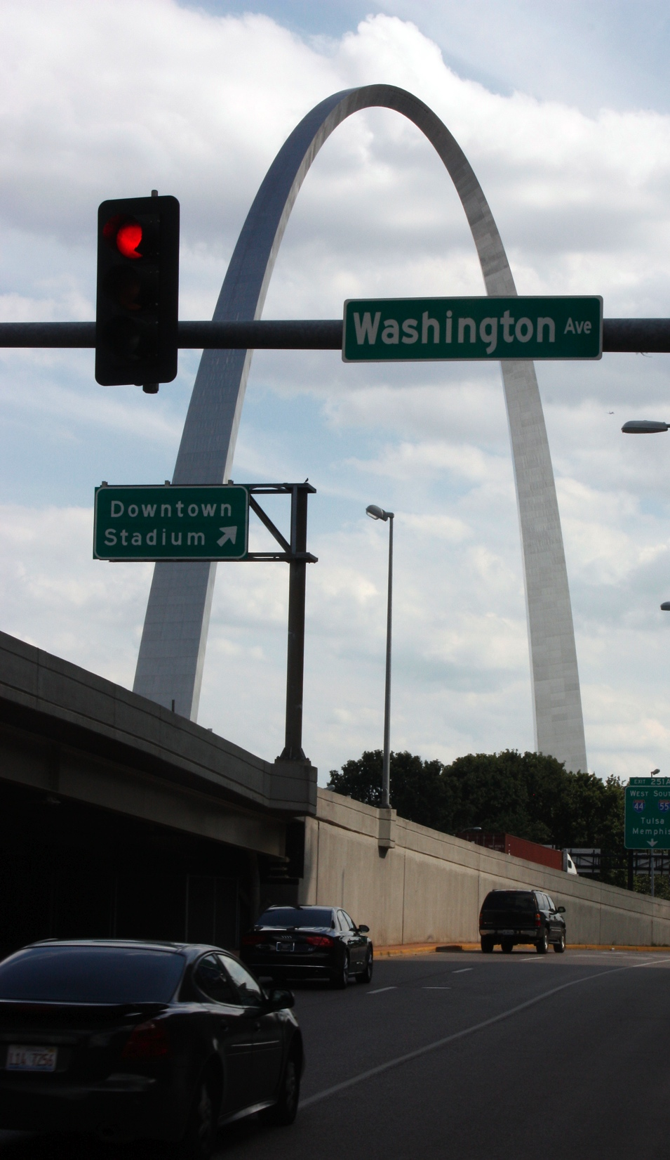
A feeling
It captures not so much an objective view of a place, but a feeling of the place.
Where is this?

Slide 5
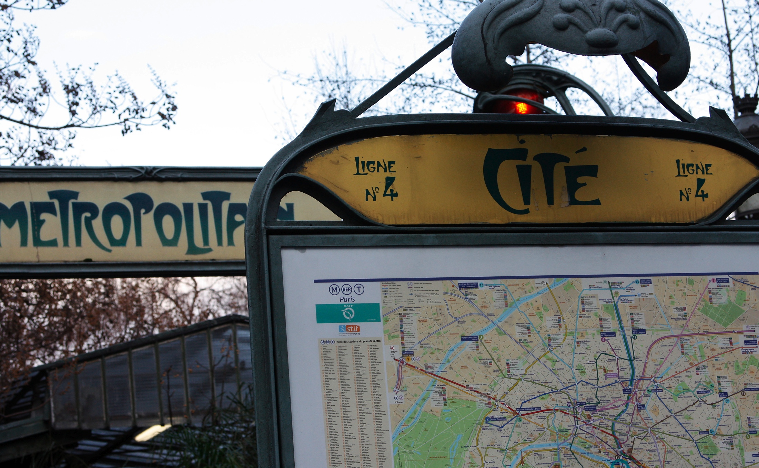
Evoke a feeling
It tries to evoke something in the viewer that says:
Where is this?

Slide 6
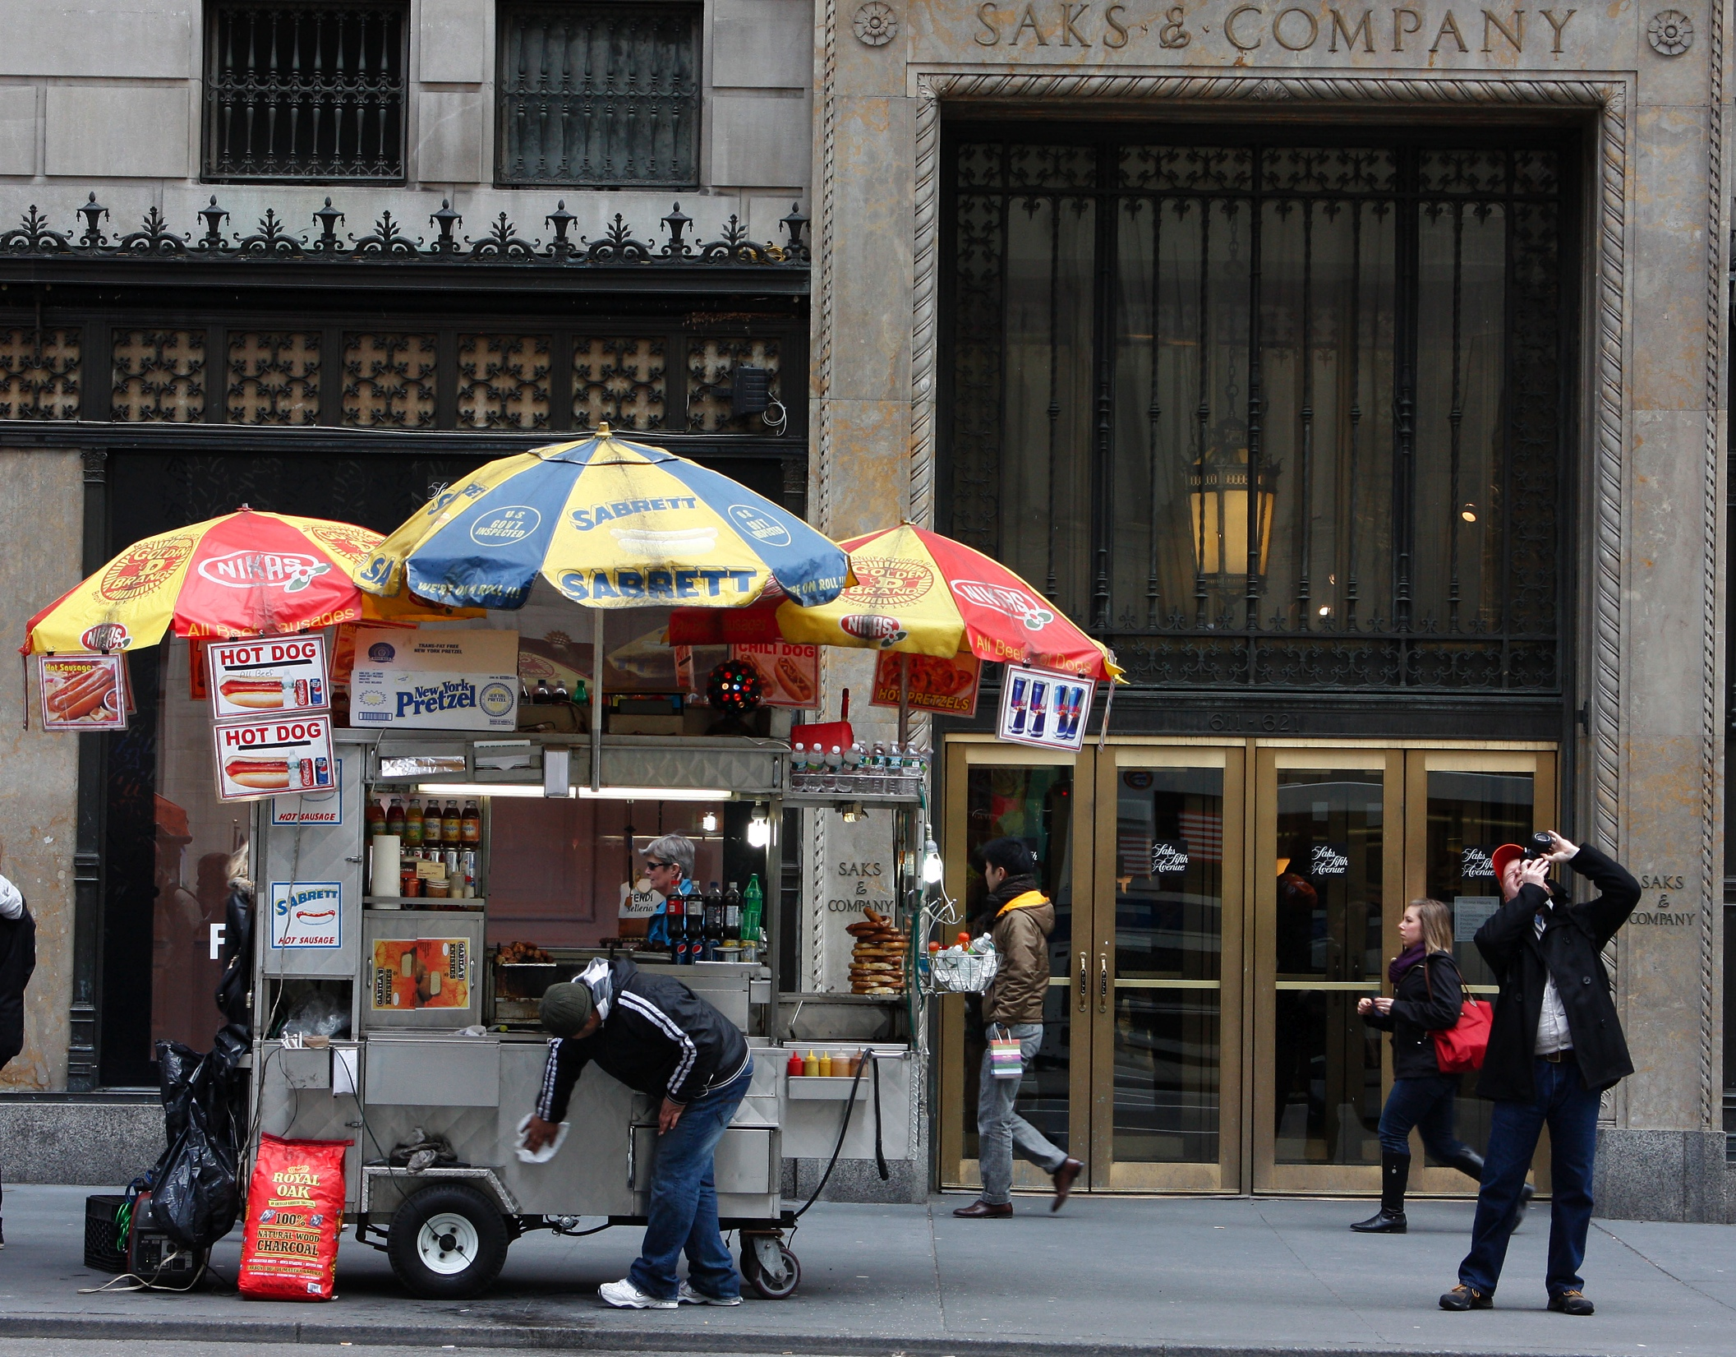
Evoke a feeling
Where is this?

Slide 7
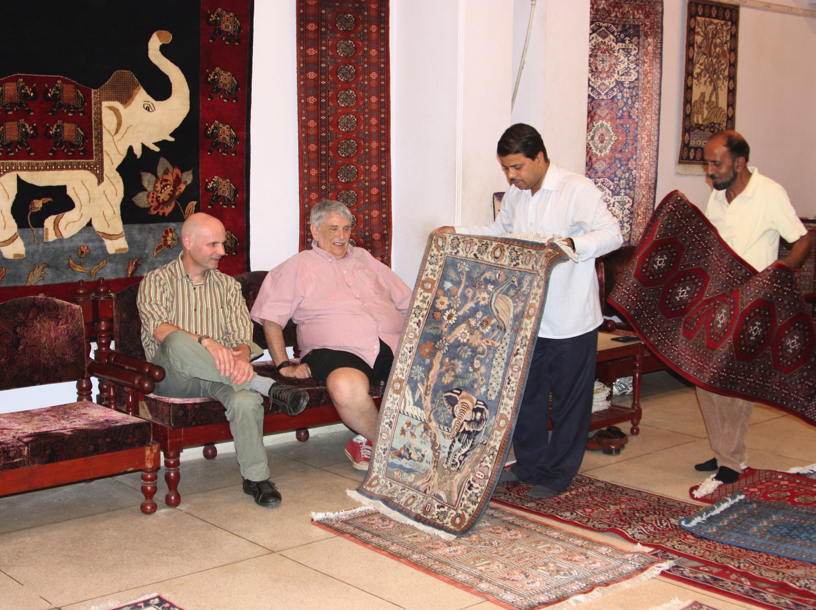
A sense of place
Where is this?

Slide 8
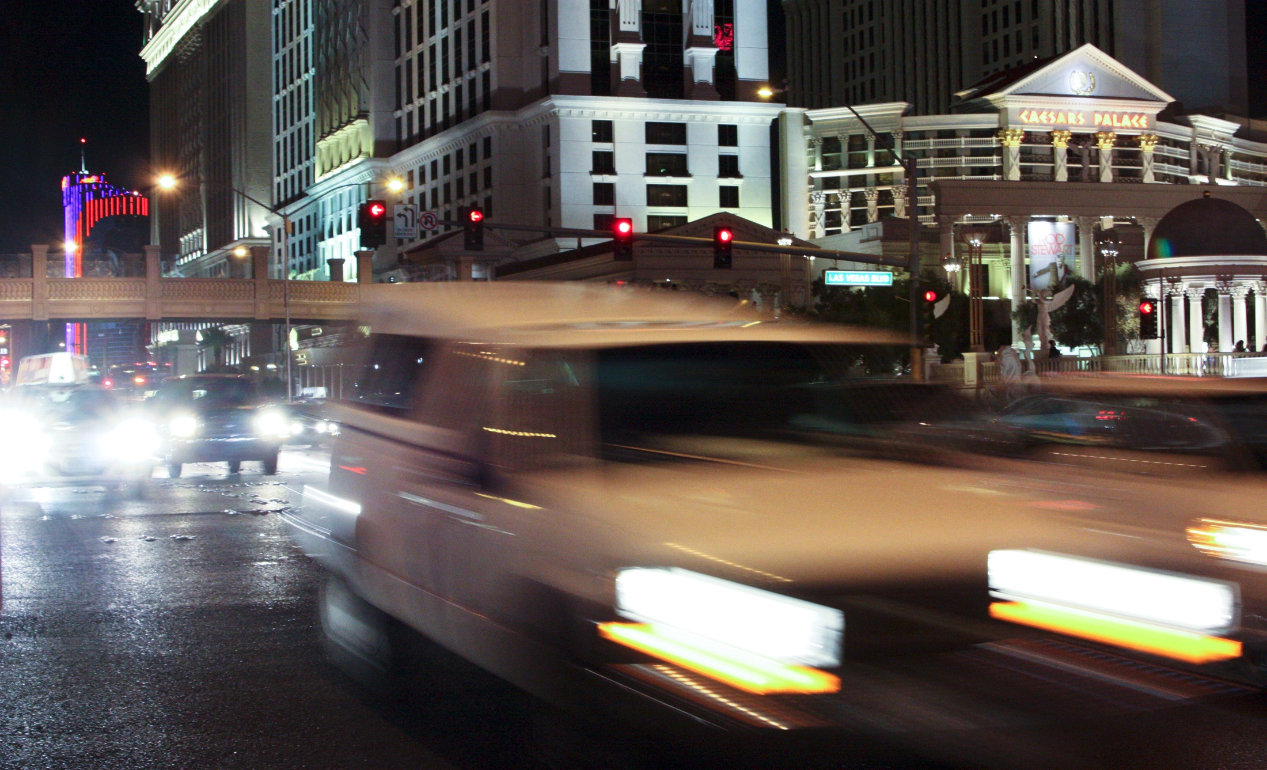
A sense of place
Where is this?

Slide 9
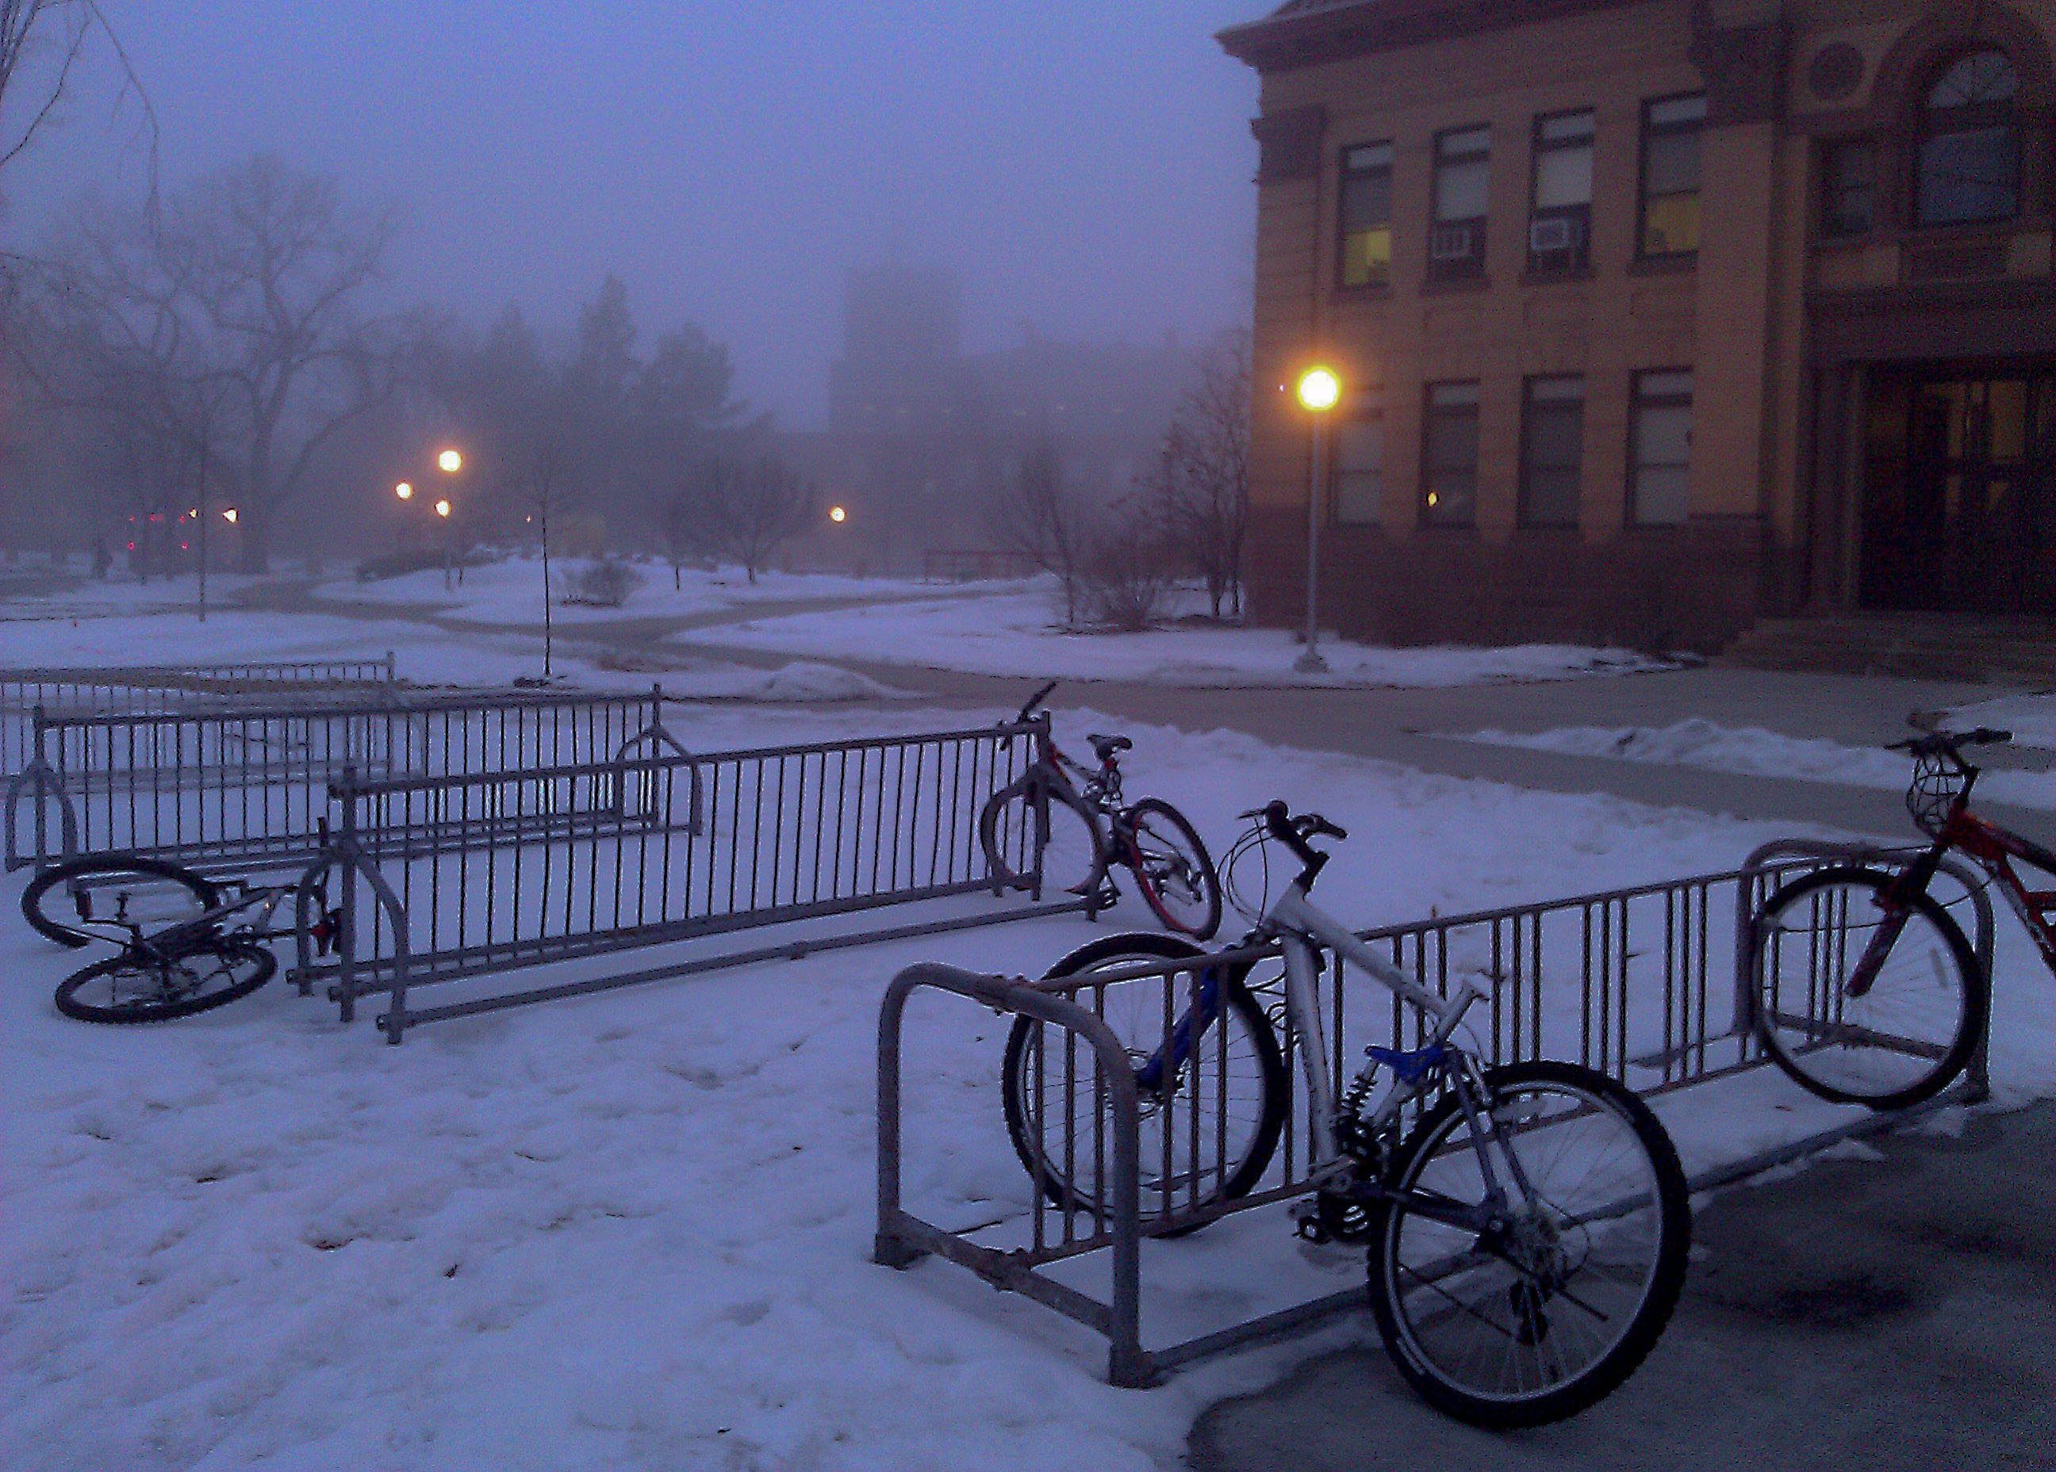
Evoke a feeling
Where is this?

Slide 10
Travel in spirit
The concept of travel photography, to capture the essence of a place, does not mean you have to go far away.
You can try to capture the feeling, the essence of your home town.
Or your university.
Or your workplace.

Slide 11
Capturing the essence
What describes a place? Two natural features often define a place:
Climate.
Landform.

Slide 12
Weather
Choosing to emphasize weather that’s typical of a place can help us to feel what it might be like to be there.
The weather we choose might not be obvious. Tropical climates are usually sunny, but we know taking pictures in the middle of a sunny day doesn’t usually product the best images.

Slide 13
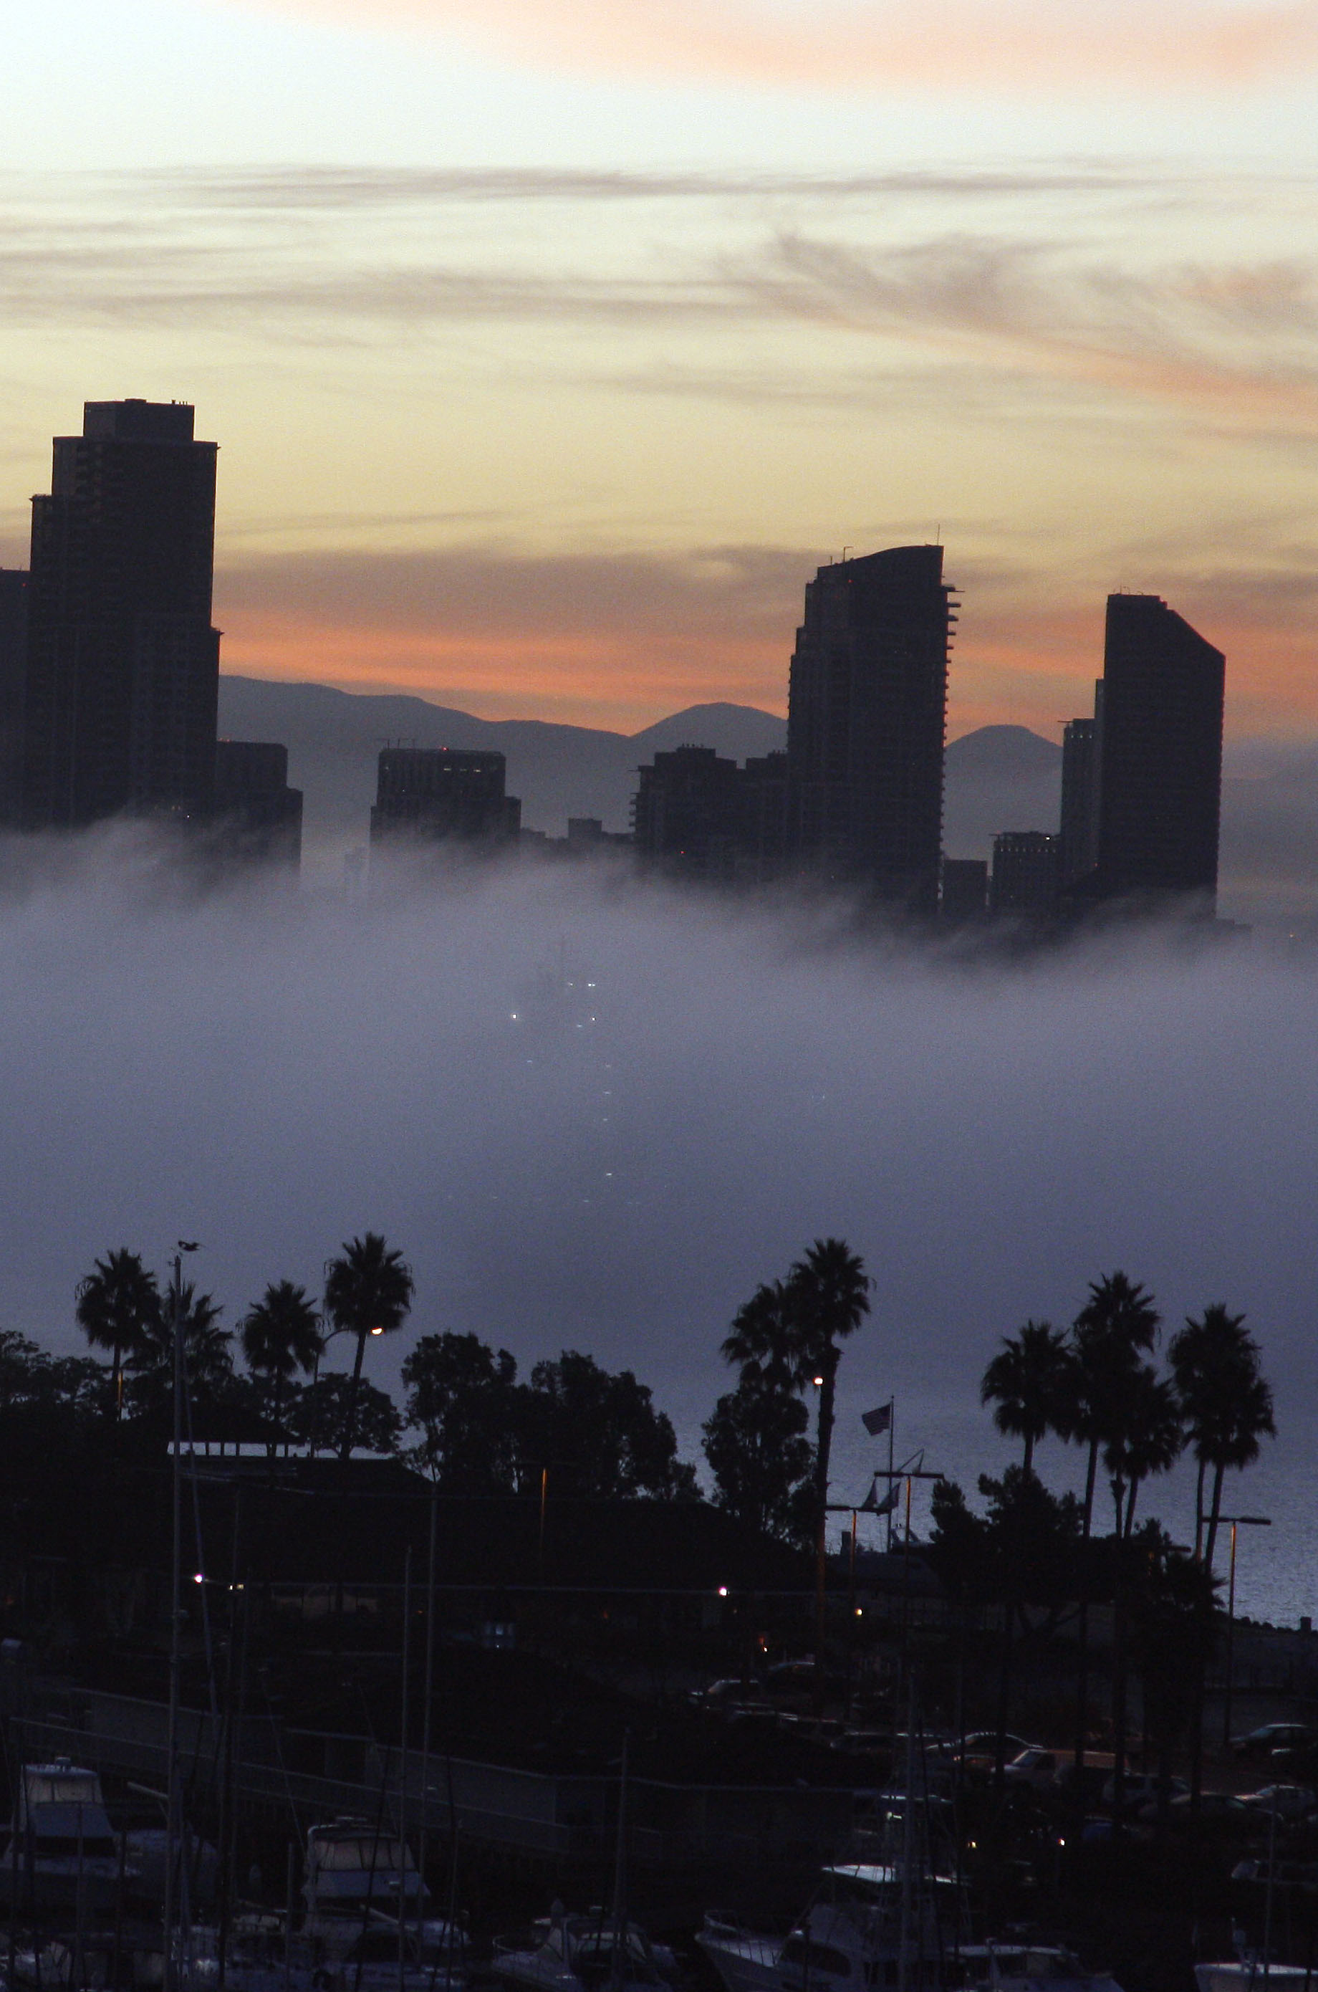
Weather
Instead, we might choose weather that helps to enhance a feeling of place, a mood we want to evoke.
Where is this? Or where is it definitely not?

Slide 14
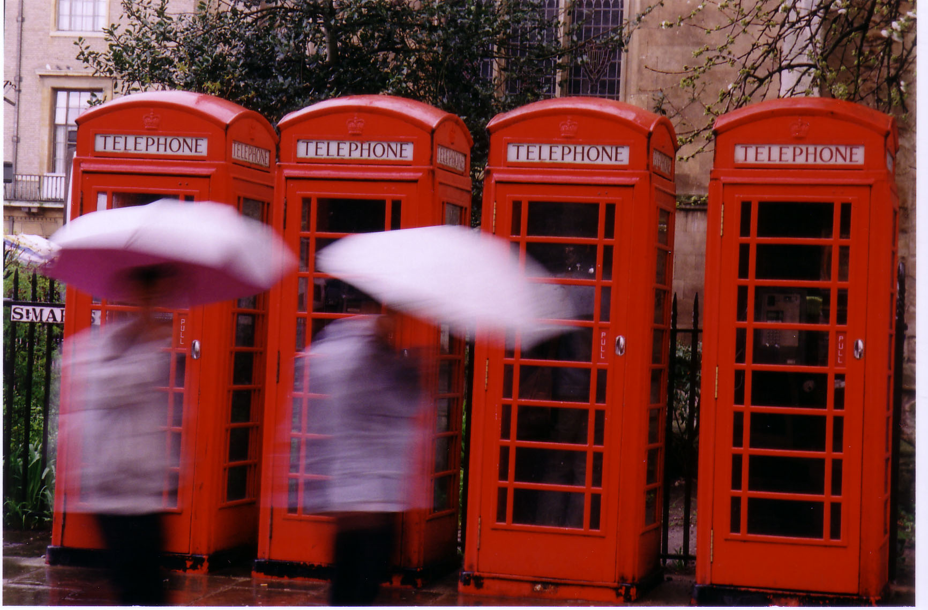
Weather
We expect rainy days in some places, and we can build on that by tying weather to typical scenes.
Where is this?

Slide 15
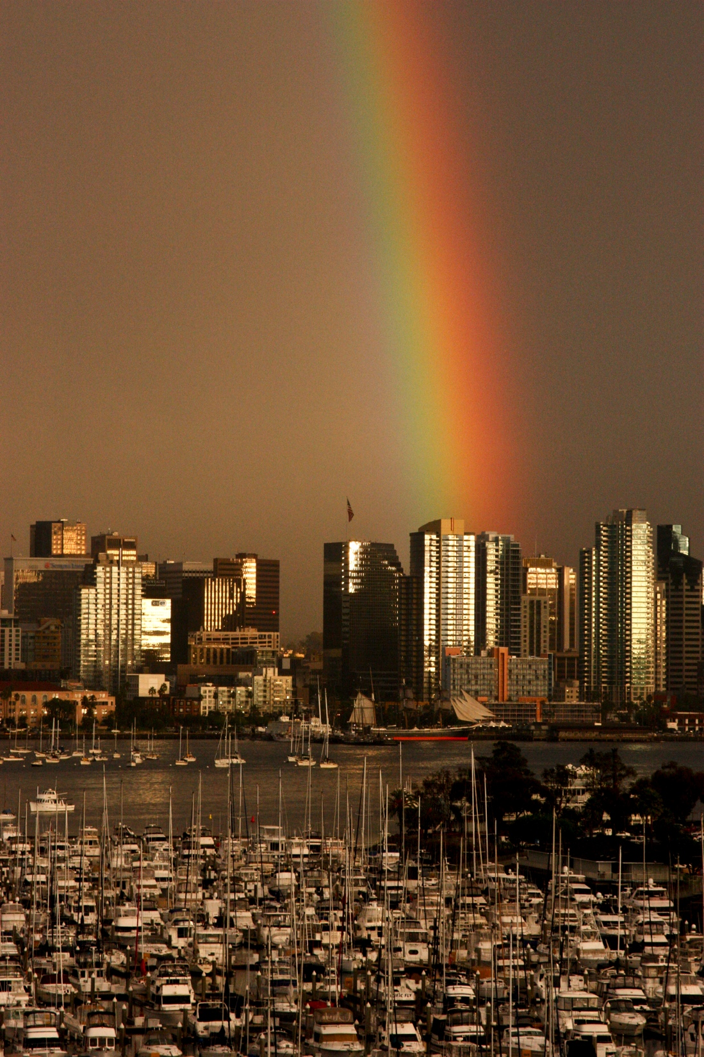
Changing weather
Weather may change quickly, sometimes in only minutes. This is particularly true at sunrise or sunset. You need to be ready, and work fast.
Where is this?

Slide 16
Land and surroundings
The place we live defines our lives: cities, mountains, plains, seashore, lakes, desert.
People live differently in response to their surroundings.
These also help to define our sense of place.

Slide 17
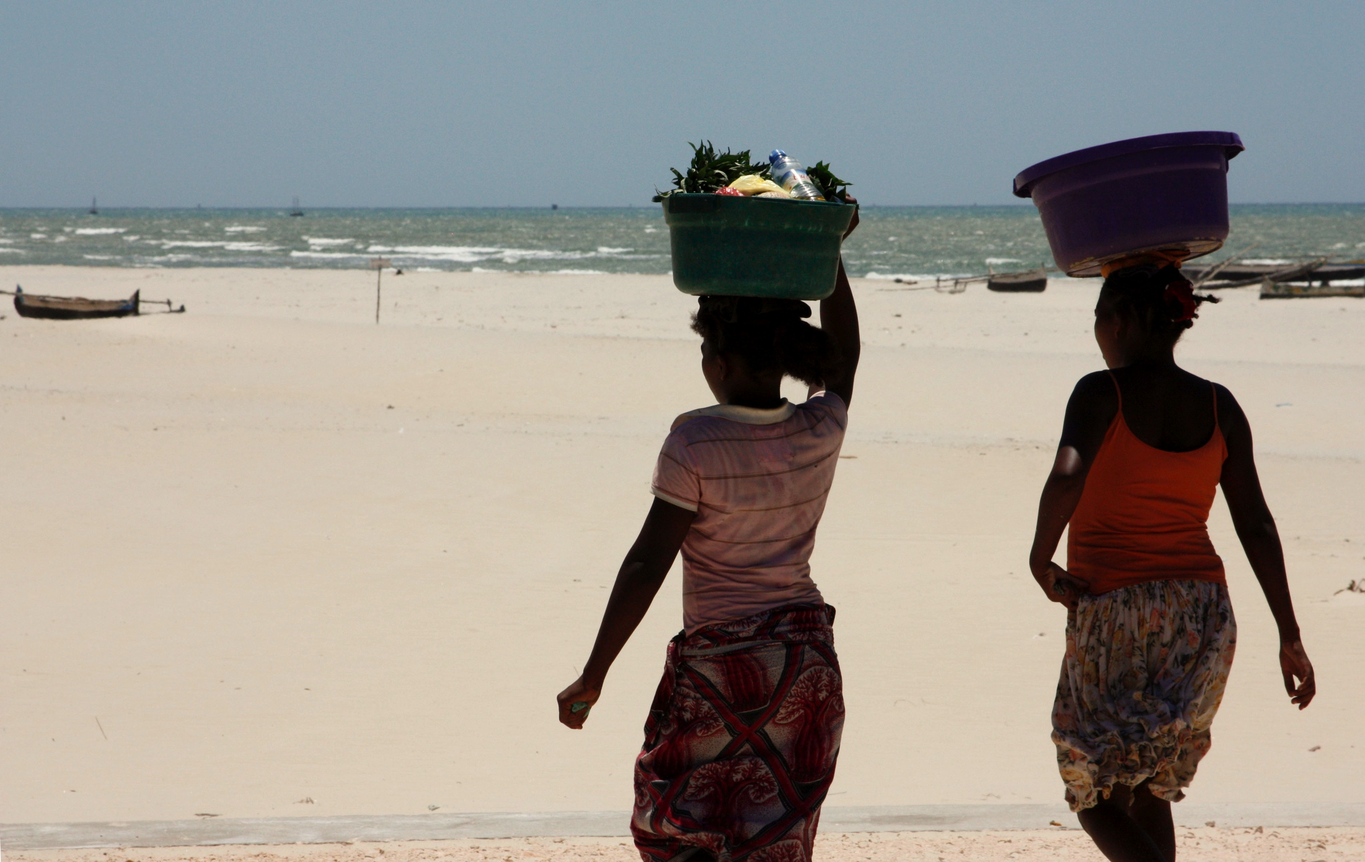
Customs and dress
Customs and distinctive dress contribute to our sense of place.
The way people walk, the things they carry, their surroundings also contribute.
Where is this?

Slide 18
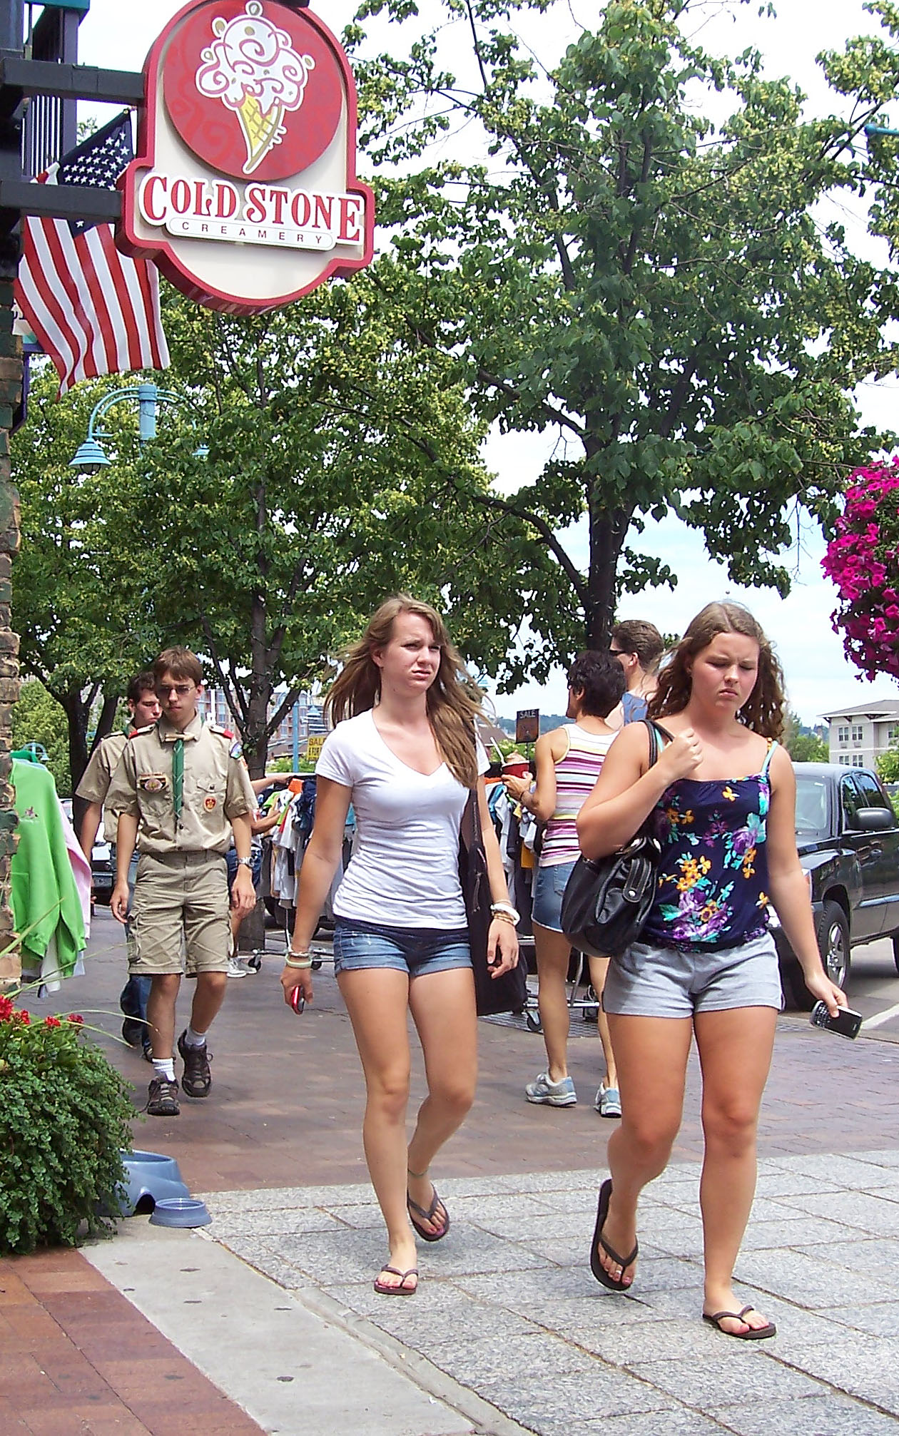
Land and culture
In what country is this picture taken?
What are the visual clues?

Slide 19
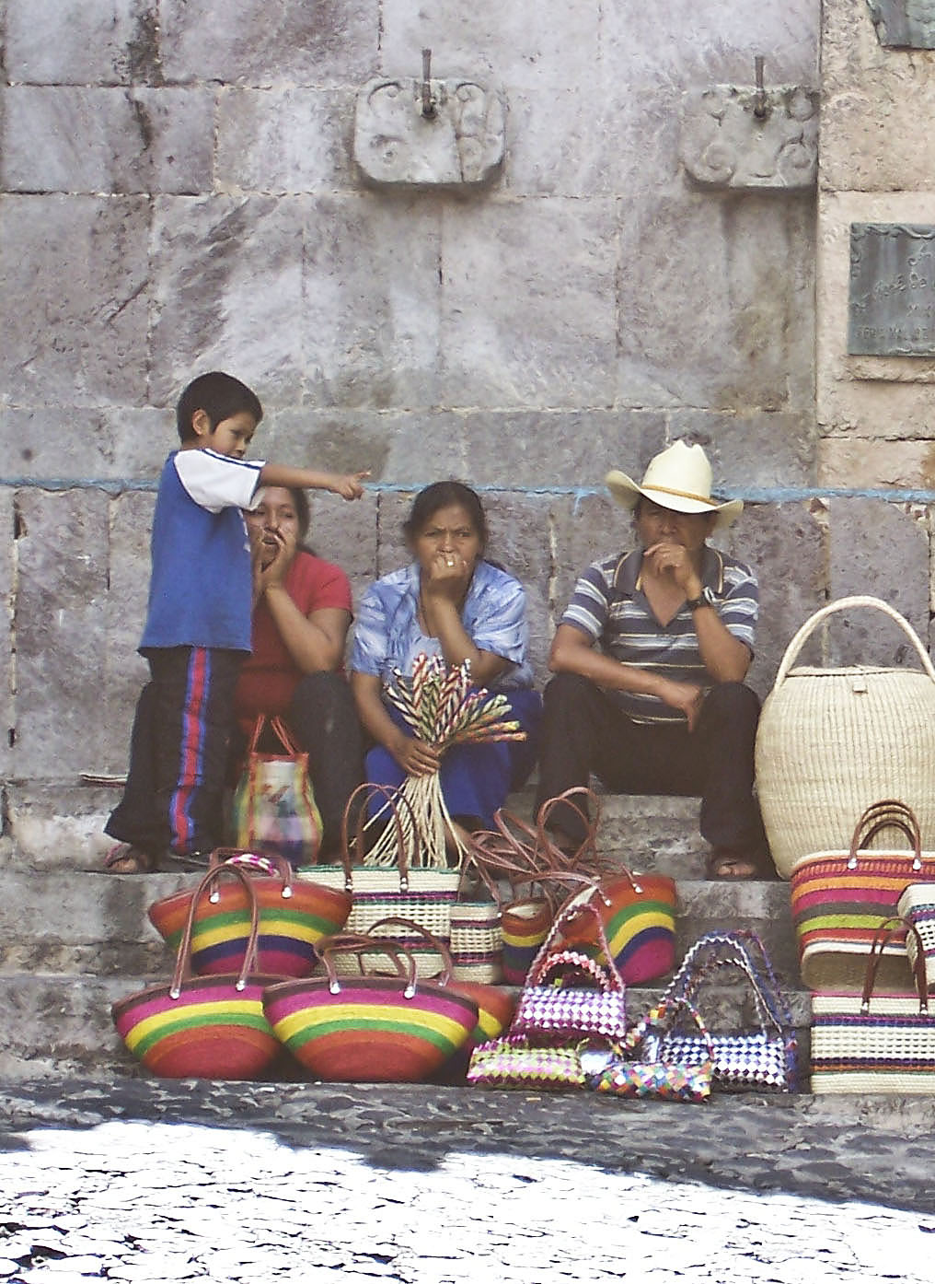
Land and culture
In what country is this picture taken?
What are the visual clues?

Slide 20
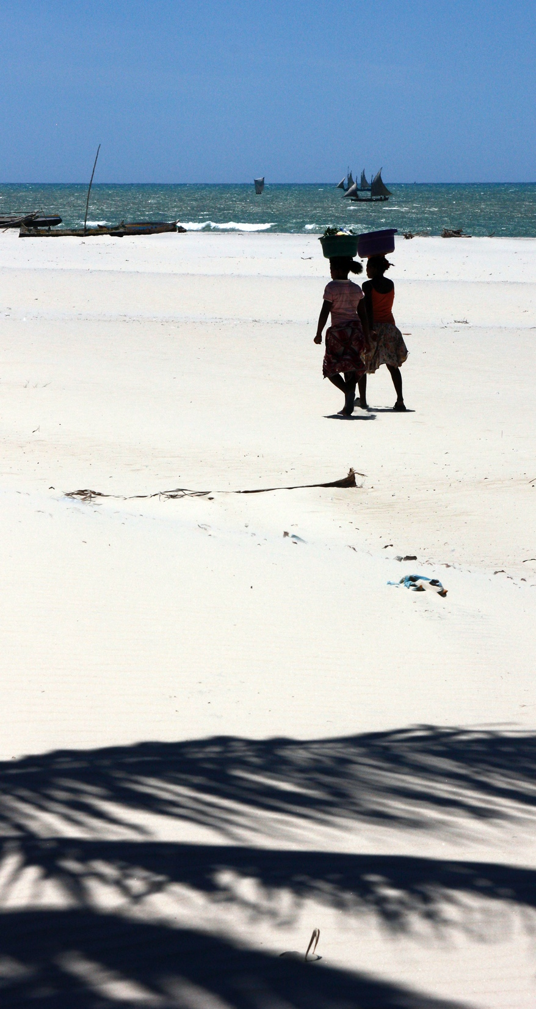
Land and people
Could this be the Midwest? Why/why not?
Could this be the United States? Why/why not?

Slide 21
Visual cues
A variety of visual cues can give a sense of place:
Worn wood and peeling paint.
Glint of ice and snow.
Narrow streets.
Color contrast.
Houses and buildings.

Slide 22
Study a place
Begin by taking a close look at your surroundings.
Travel photographers sometimes begin by touring the area without a camera.
You can soak in the ambience, and get a feeling for what might make a good photo.

Slide 23
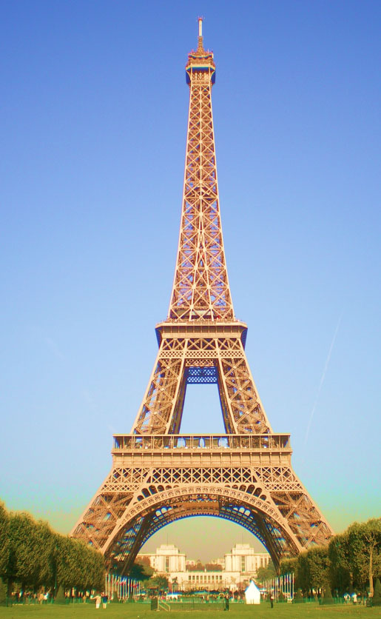
Avoiding clichés
Photojournalists try to avoid cliché images in giving a sense of place.
For example, everyone knows the Eiffel Tower is in Paris. But taking yet one more photo is a cliché. Try to find something new.

Slide 24
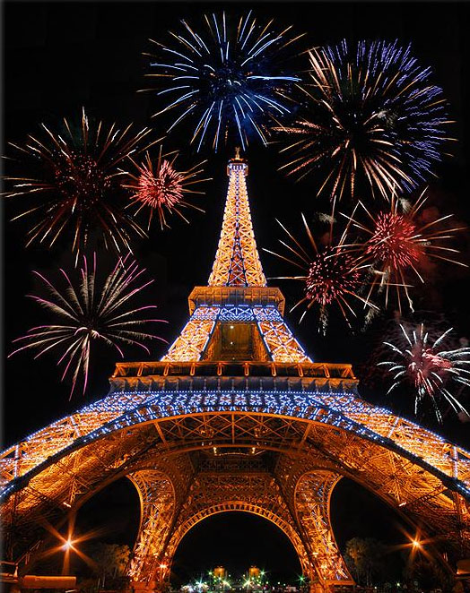
Working a cliché
You can, however, take a cliché photo in an unusual way.

Slide 25
Campus clichés
What might we consider a cliché image of the NDSU campus?
Could we take the photo in a way to avoid the cliché image?

Slide 26
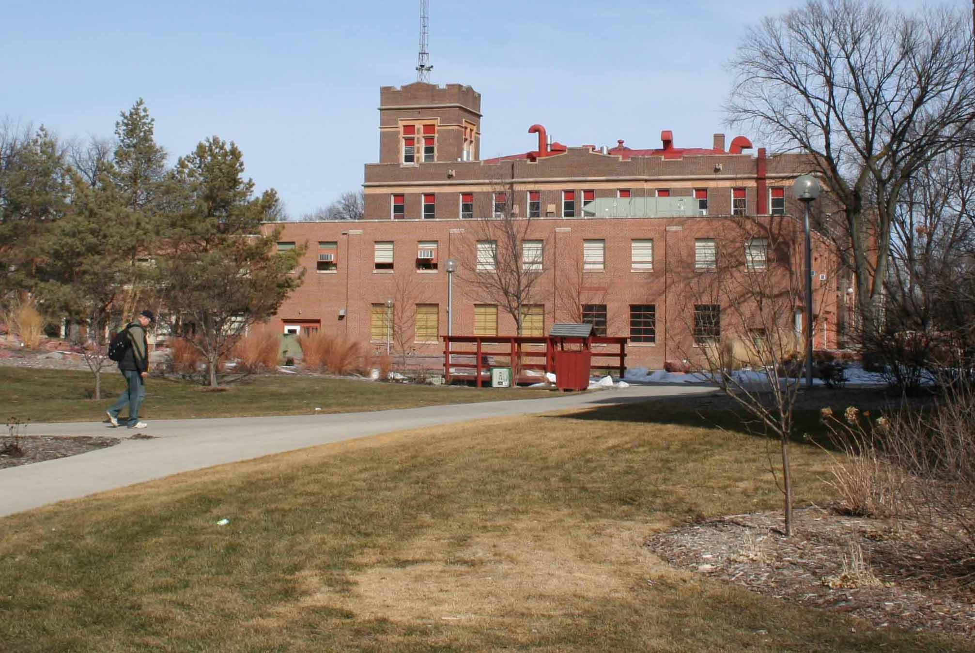
On campus
Here is one typical NDSU campus scene.

Slide 27
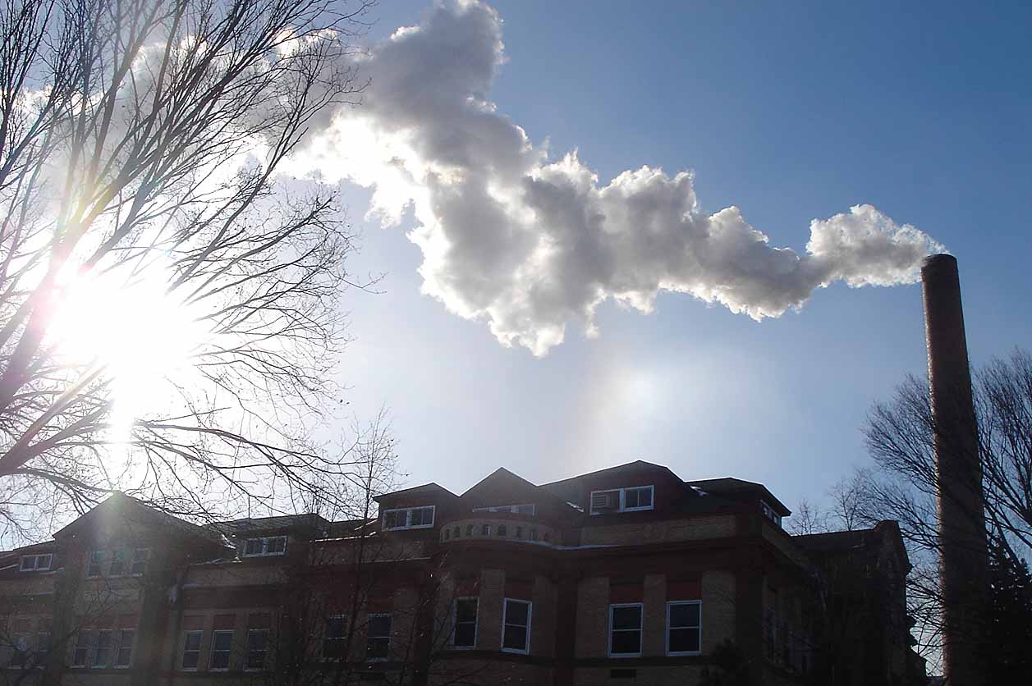
On campus
And one student’s attempt to try something different. We do miss having people in the scene.

